Slide 1
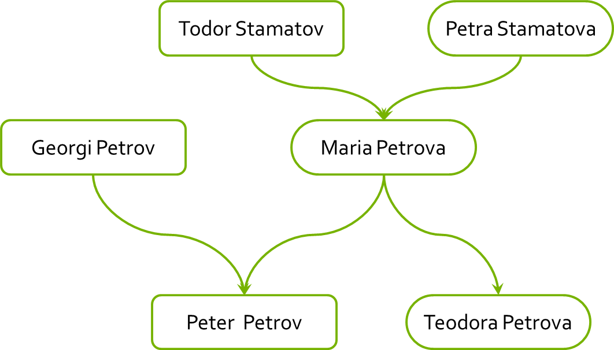
Read the tutorial on KineticJS:
At http://www.html5canvastutorials.com/kineticjs/html5-canvas-events-tutorials-introduction-with-kineticjs/
Read about custom shapes and text
Using Kinetic create a family tree
var familyMembers = [{
mother: 'Maria Petrova',
father: 'Georgi Petrov',
children: ['Teodora Petrova', 'Peter Petrov']
}, {
mother: 'Petra Stamatova',
father: Todor Stamatov',
children: ['Maria Petrova']
}]

